Slide 1
CNN Project
Image Classification - CIFAR-10
Notes:
CONVOLUTIONAL NEURAL NETWORK
a type of neural network that learns using filter (or kernel) optimization. This type of deep learning network to make predictions from many different types of data including text, images and audio.

Slide 2
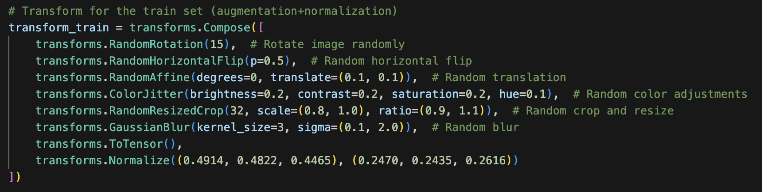
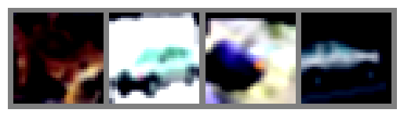
Data Preprocessing
Loading the CIFAR-10 dataset:
Size: 60,000 images, 32×32 color images in 10 classes, balanced set
Classes: airplane, automobile, bird, cat, deer, dog, frog, horse, ship, truck
Normalizing and augmentation:
Frog automobile bird automobile
Notes:
A quick guide through data preprocessing : - Start by loading the CIFAR-10 dataset:
Size: 60,000 32×32 color images in 10 classes, balanced
Classes: airplane, automobile, bird, cat, deer, dog, frog, horse, ship, truck
Augmentation and normalising was one of the most important steps, since it helped get a better result. I did different new kind of augmentation and I force the normalization so the training was quicker (the values are the mean and standard deviation for each color channel). The goal is to center this around 0 and scale it. For example, For a red pixel value, you subtract 0.4914 and divide by 0.2470.
This is a preview of the dataset once I finished this process

Slide 3
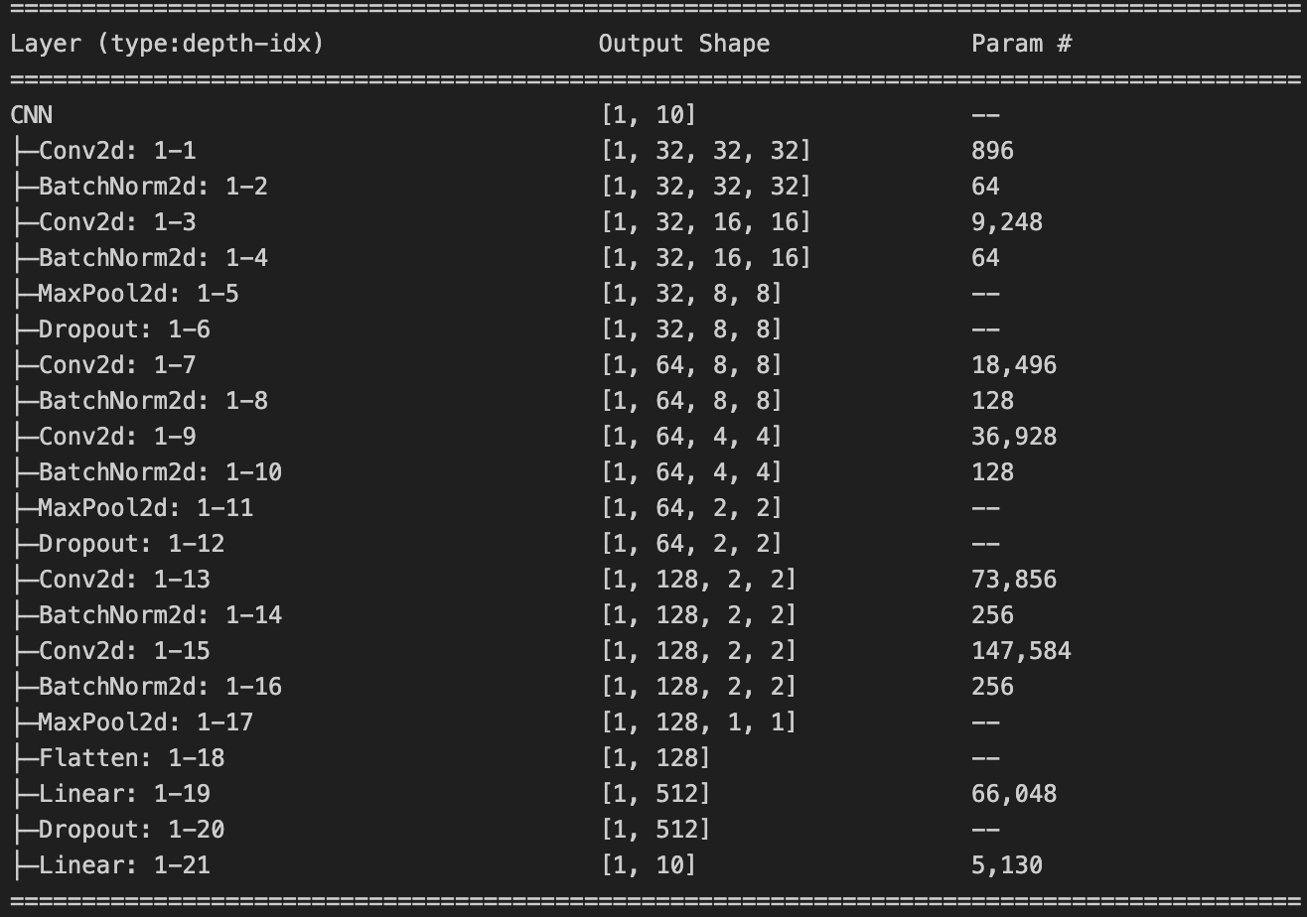
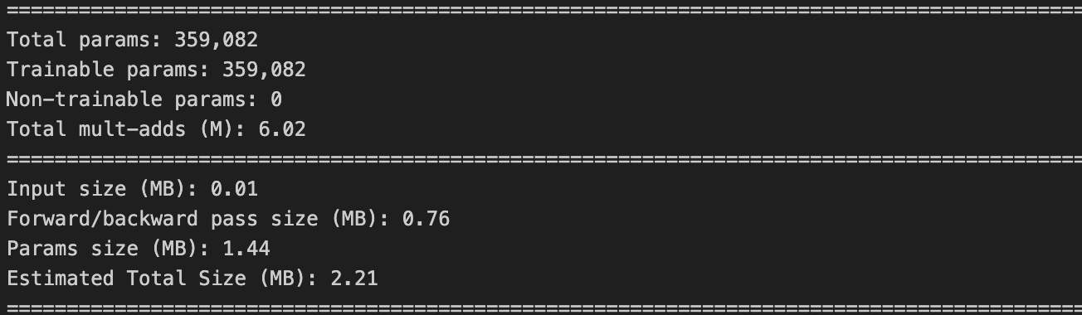
Building a custom CNN
6 2D convolutional layers:
Pooling, Dropout, Batch normalization
ReLU as activation function
Utility function for adjusting the Linear layer
Notes:
MaxPooling takes the maximum value in each region of the window. I did 2
Dropout randomly sets to zero a fraction of the neuron’s in a layer, so the network learns redundant representations so it improves generalisation. I did 0,25
Batch normalization normalises the output of a layer for a mean of 0 and a standard deviation of 1.
Rectified Linear Unit as activation function, it introduces non-linearity helping to reduce the vanishing gradient problem. ReLU "activates" only positive values and sets all negative values to zero. I chose ReLu because is a multi-class classifier (Sigmoid was discarded) and because my model got stagnant really quick.
Its purpose is to automatically determine the correct input size for the first fully connected (Linear) layer
It creates a dummy input tensor with the same shape as your images (e.g., (3, 32, 32) for CIFAR-10).
It passes this dummy input through all the convolutional, pooling, and flatten layers of your model (without training or updating weights).
It checks the output shape after flattening, which tells you how many features are needed as input for the first Linear layer.
It then redefines fc1 (the first fully connected layer) to have the correct number of input features, avoiding manual calculation and errors.

Slide 4
Defining the model
Early stopping:
patience=5, min_delta=0
Initial setting: patience=3, min_delta=0,2 -> Bad result, too aggressive
Loss function:
Cross entropy: standard loss function for multi-class classifiers.
Optimizer:
Adam -> lr=0.001 and weight decay=1e-4 (adds L2 regularisation)
Scheduler:
Cosine Annealing.
Notes:
Early stopping to stop training when validation loss stops improving.
Args:
patience (int): How many epochs to wait after last improvement
min_delta (float): Minimum change to qualify as an improvement
Loss function: It penalizes the model more when it is confident but actually is wrong, encouraging correct and confident predictions.
Adam: Adaptative moment Estimation: LR by default and weight_decay=1e-4 adds L2 regularization, which helps prevent overfitting by penalizing large weights.
Cosine Annealing (Scheduler): This scheduler adjusts the learning rate following a cosine curve. It’s adjusted to one cosine cycle over 30 epochs (the epochs I selected for my model). The result is a smooth descent around the cosine.
If you do not set a scheduler, the learning rate remains constant throughout training (it stays at the value you set in the optimizer, e.g., lr=0.001 for Adam). the learning rate would not change automatically during training.

Slide 5
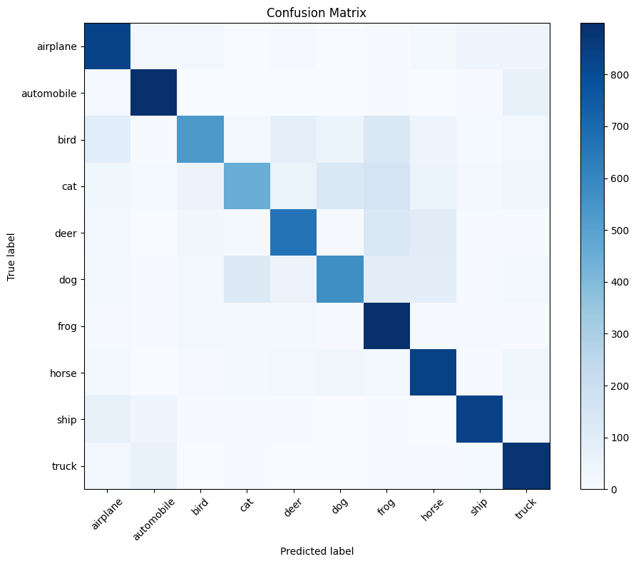
The result:
Best model from epoch 27
Best validation accuracy: 0.7398
Best validation loss: 0.7357
Epoch [30/30], Loss: 0.9219, Acc: 0.6779, Val Loss: 0.7379, Val Acc: 0.7375, LR: 0.000001
Precision: 0.7429
Recall: 0.7398
F1-score: 0.7324
Notes:
Not overfitting nor underfitting in my opinion
These results don’t show overfitting (a large gap between high training accuracy and lower validation accuracy) or underfitting (both loss are high, and both accuracies are low).
Rows: Actual (true) classes
Columns: Predicted classes
Each cell [i, j] shows how many images of class i were predicted as class j.
We can see, that even when a cat is a cat, it’s not highly efficient, but there’s not much of misclassifications.

Slide 6
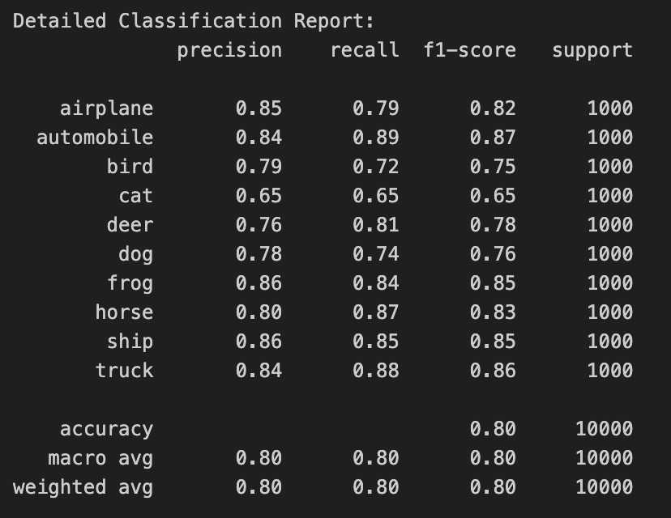
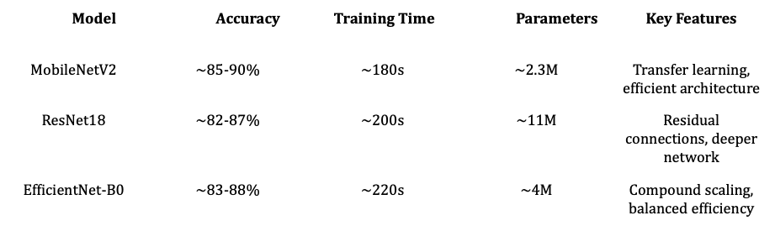
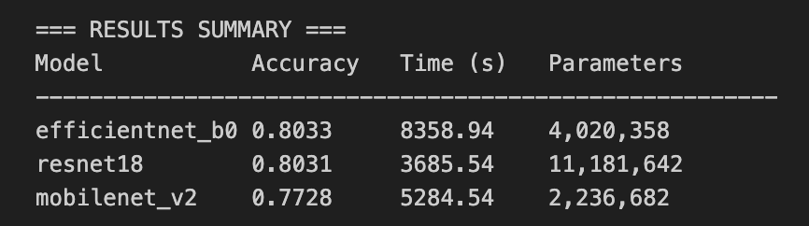
Transfer learning
Comparative and evaluation
Models tested:
Notes:
As you know, transfer learning is a machine learning technique where a model developed for one task is reused as the starting point for a model on a second, related task.
Taking a neural network pre-trained on a large dataset (like ImageNet).
Keeping most of its learned weights (features).
Replacing and retraining only the final layers for your specific task (e.g., CIFAR-10 classification).
At first, I tried with Resnet18, but the output wasn’t good enough and I had problems with deployment, so I chose MobileNetV2, which gave me better results. With Resnet18, everything that I tested was an airplane.
But yet, the best was efficientnet_b0, which I discarded because of the time of training.
Also, I only did 3 epochs of each because it took too much time!

Slide 7
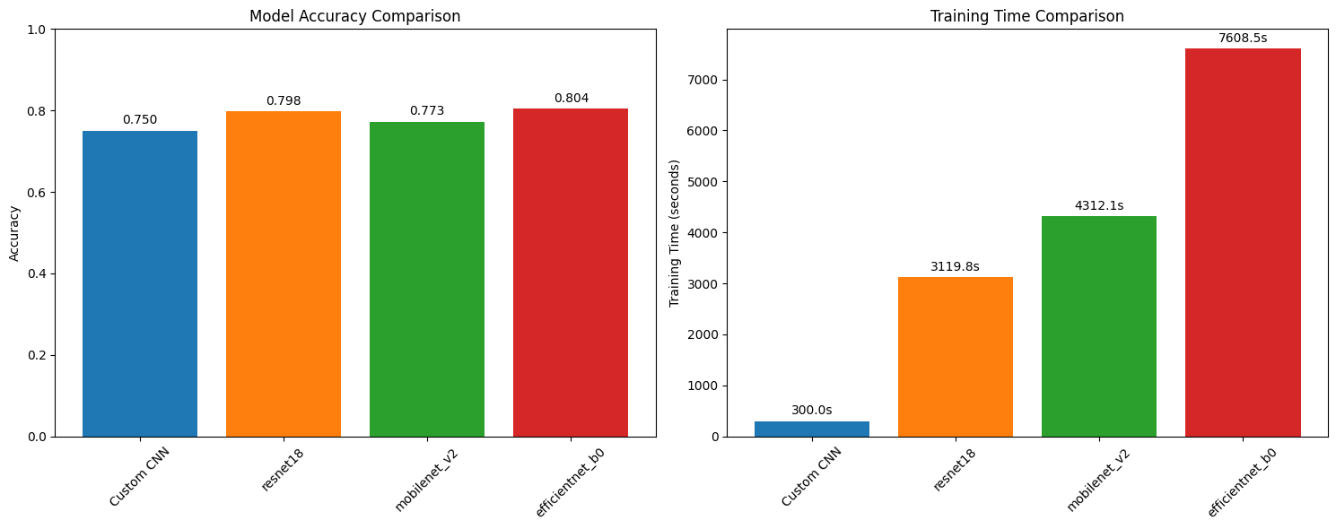
Notes:
As you see, if we use accuracy as the main stat to keep in mind, there’s not a big difference among the models.

Slide 8
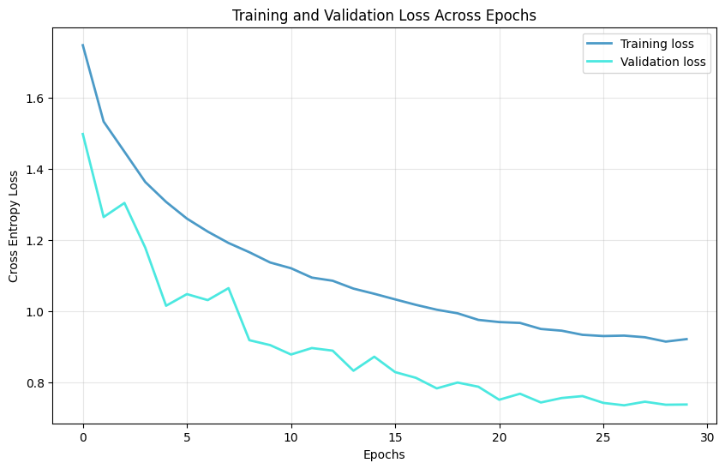
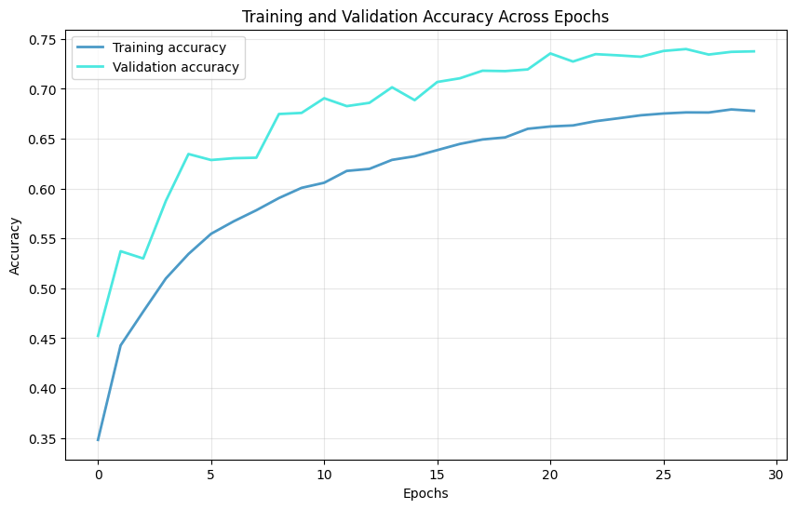
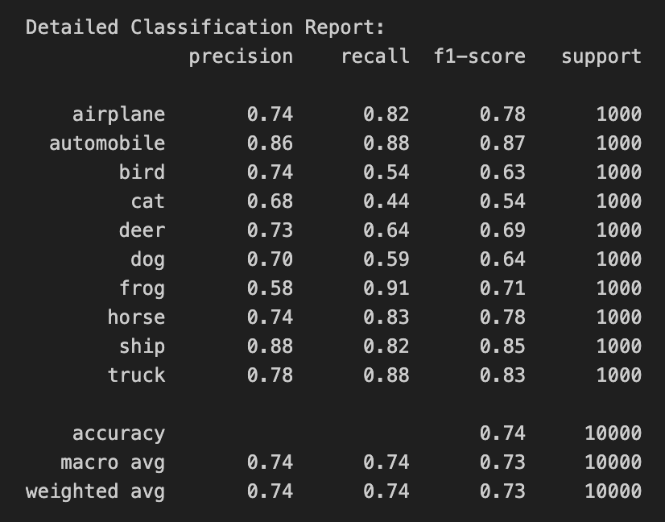
Transfer learning
MobileNetV2
Chosen model: MobileNetV2.
Notes:
Small, light, good for small images and good results. I wanted something light for the deployment (at first I tried ResNet18, but it was too heavy and the results weren’t so different)
The curves shows a good tendency, even if the result is not extraordinary. The validation set is very sharped,
A "sharp" (or erratic, unstable, or noisy) validation loss curve across epochs in machine learning typically indicates instability or problems with the training process or the dataset itself, suggesting that the model is having difficulty finding a stable, generalizable solution. Maybe the learning rate is too high.
For the comparison, the one at right is Efficient NET
all layers are frozen except the final classifier layer. So, you are using just one unfrozen (trainable) layer in each transfer learning model—the final classifier layer.

Slide 9
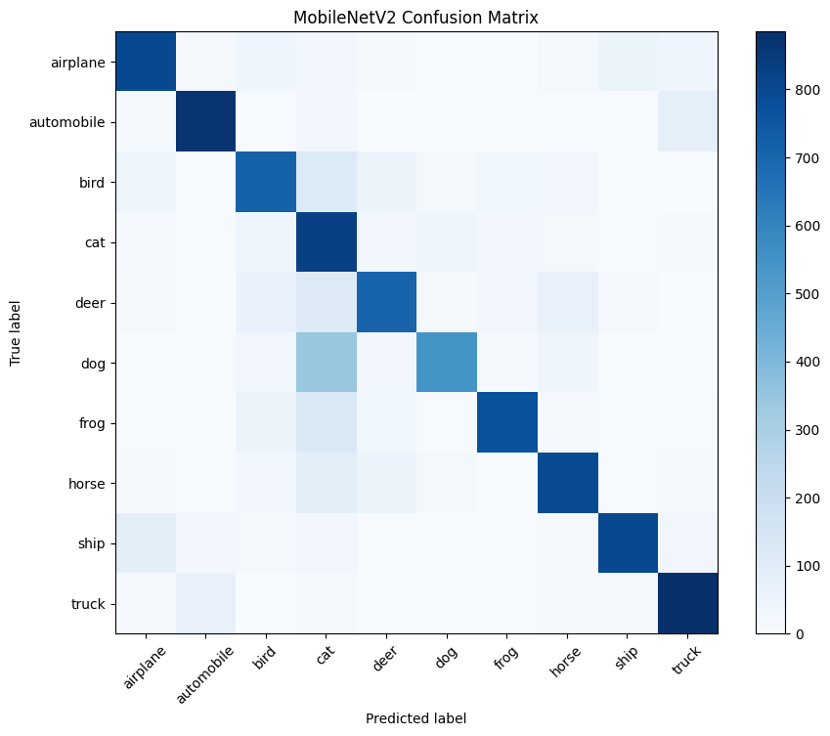
The result:
Accuracy: 0.7398
Precision: 0.7429
Recall: 0.7398
F1-score: 0.7324
Notes:
Rows: Actual (true) classes
Columns: Predicted classes
Each cell [i, j] shows how many images of class i were predicted as class j.
We can see, that even when a cat is a cat, it’s not highly efficient, but there’s not much of misclassifications.
In a perfect matrix confusion, only the diagonal are non-zero.

Slide 10
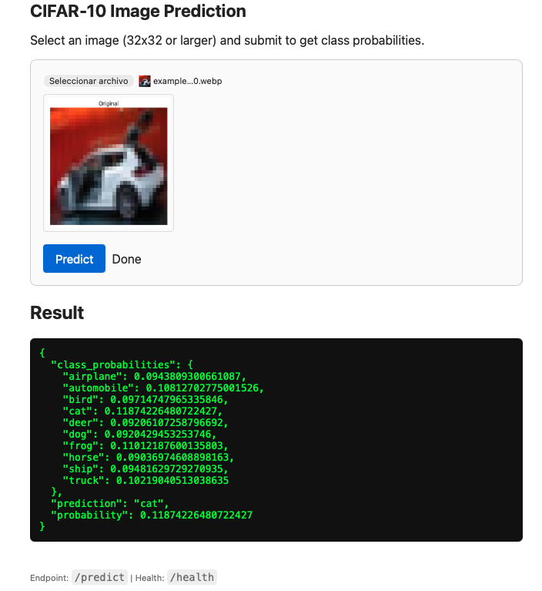
Deployment
Flask and PyTorch
Results:
It doesn’t reconigze everything as an airplane.
It works well with frogs.
Automobile and trucks almost the same.
THE LINK
Thank you

